Slide 1
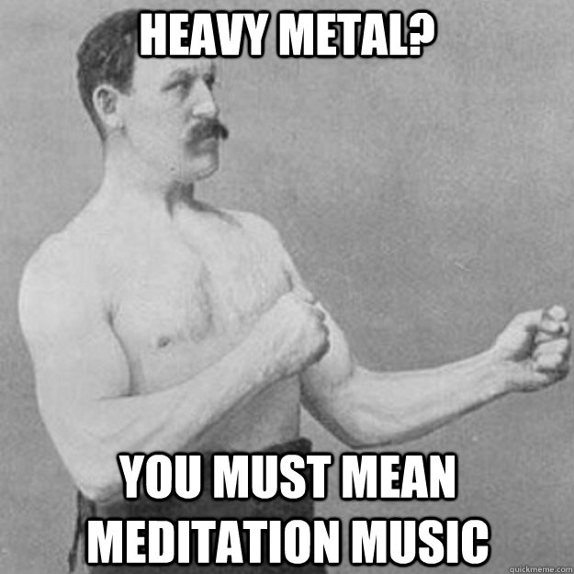
Notes:
For introducing DJ

Slide 2

A collaborative approach to translational research:
The mutual interest model
Michael P. Twohig, Ph.D.

Slide 3
Disclosures (support):
Michael Twohig, Ph.D.
Relevant Financial Relationships:
Employed at Utah State University
Research partially funded by grants from:
International OCD Foundation
State of Utah-TANF
Receive royalties from New Harbinger publications and Oxford University Press for books co-written on a topic similar to the subject of this presentation

Slide 4
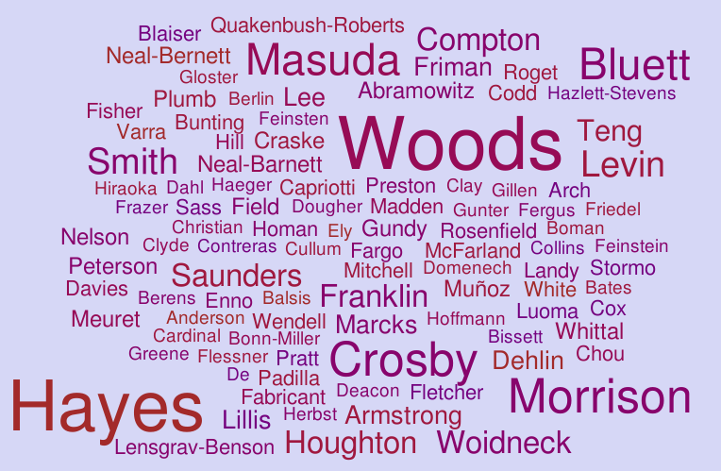
Ong

Slide 5
Ong

Slide 6
Ong

Slide 7


Slide 8
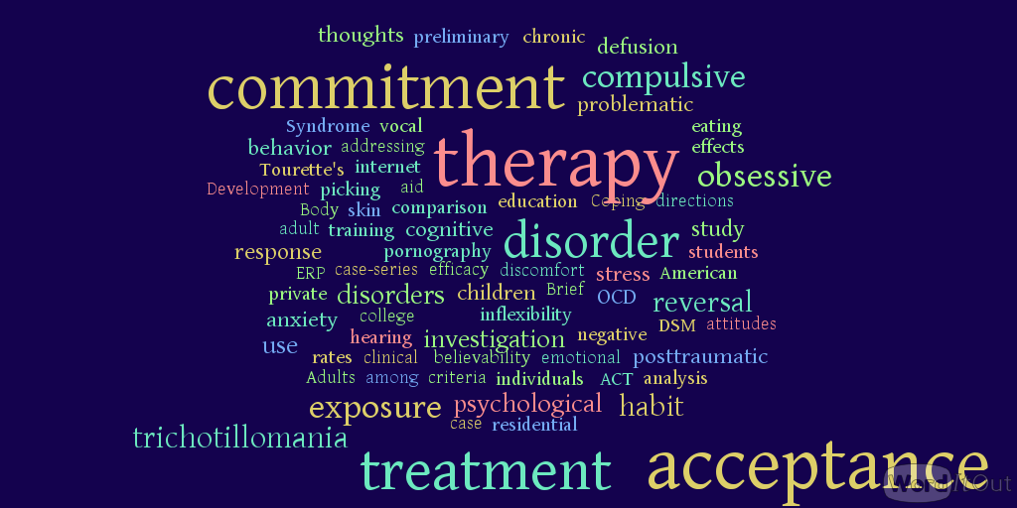
Notes:
Before transitioning to next slide: “I found this talk odd as I was preparing it because it was not about a research topic, it’s about a process. I’m going to talk about my research process over the last 17 years. Hopefully there is something inspirational in there for someone.”

Slide 9
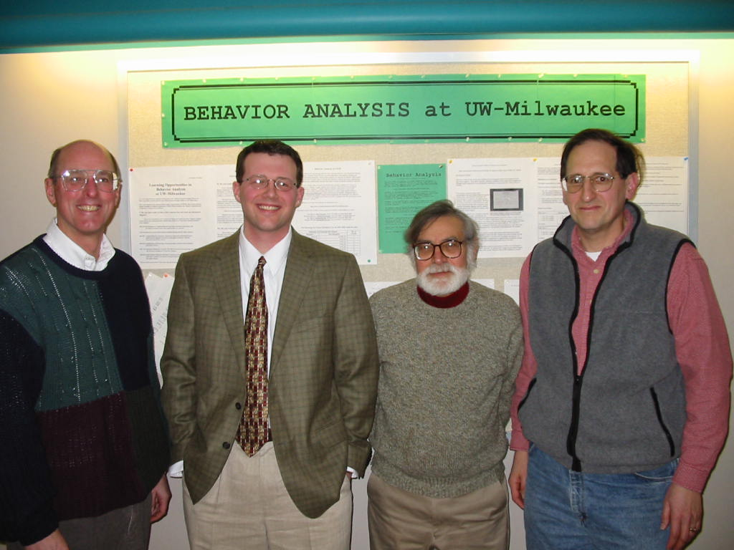
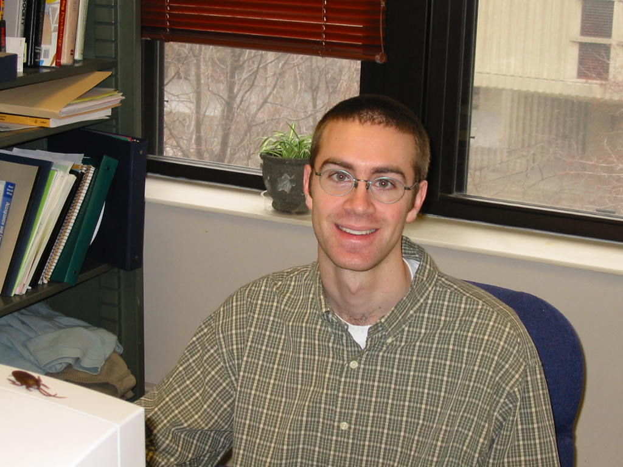
Fortunate events
Notes:
UWM….work with Baron accidentally….BA with kids with autism…Doug comes to USU…start working with kids and adults doing BA…at one ABA (next slide)

Slide 10
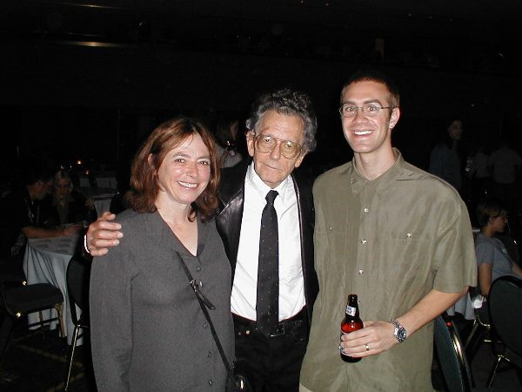
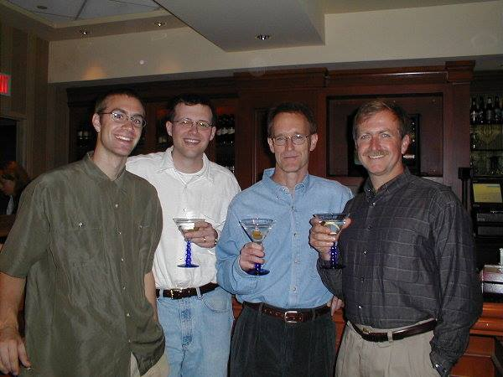
Introduced to behavior analysis
Notes:
Talk about my first introduction to ACT and then my first ACT training.

Slide 11

Notes:
ACT workshop..hard transition from traditional BA to clinical BA

Slide 12
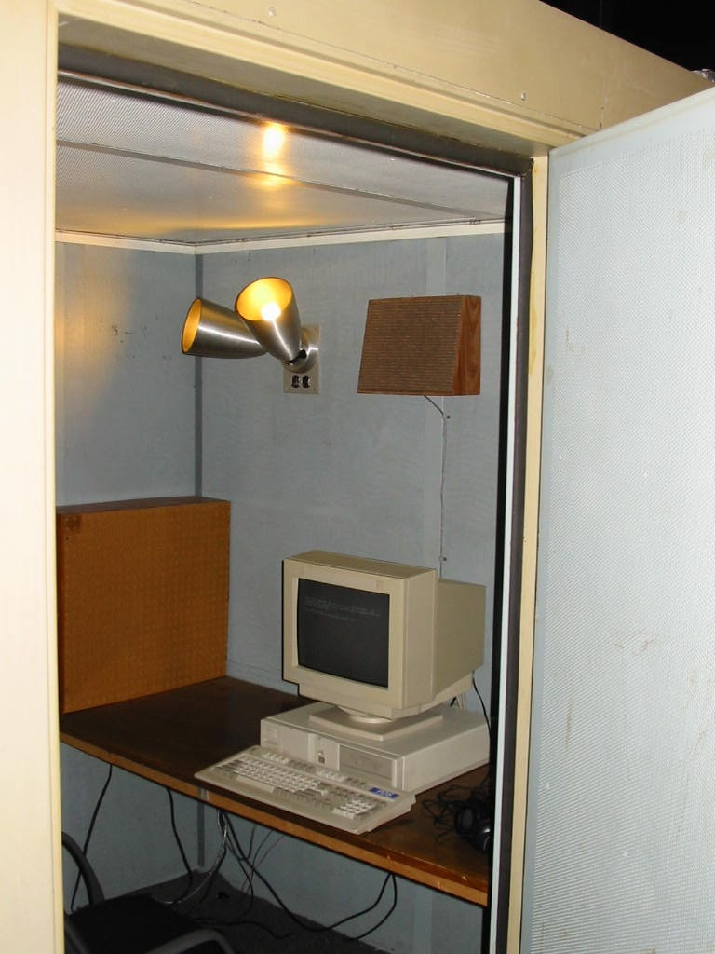
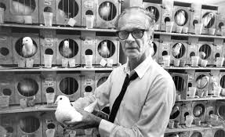
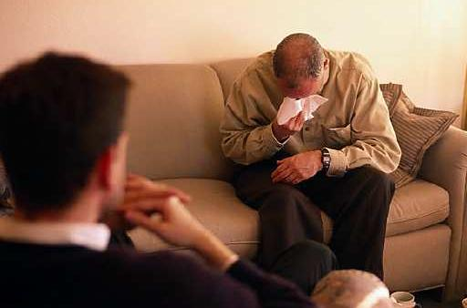
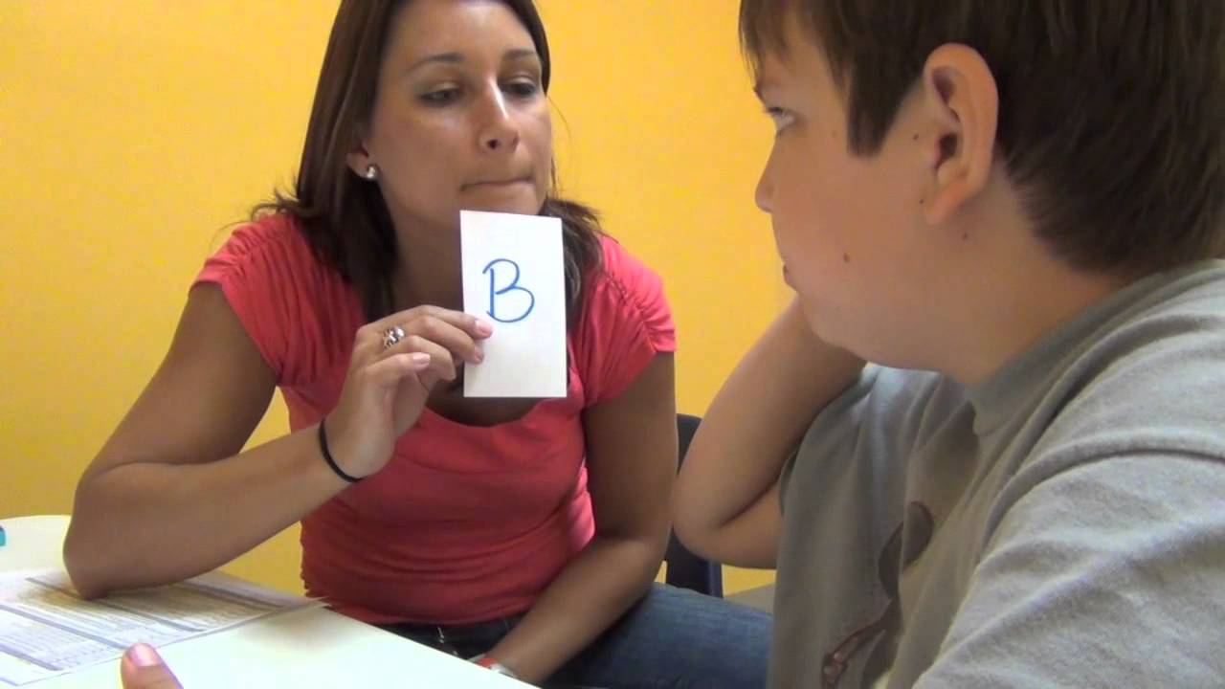
Translational work
1
2
4
3

Slide 13
My first example of translational work

Slide 16
Notes:
Tell story

Slide 17
Translational work

Slide 18
Academic Values
Notes:
Why did Jay want to work with us…my guess is that we tapped into some value of his and he was happy to give us his time.

Slide 20
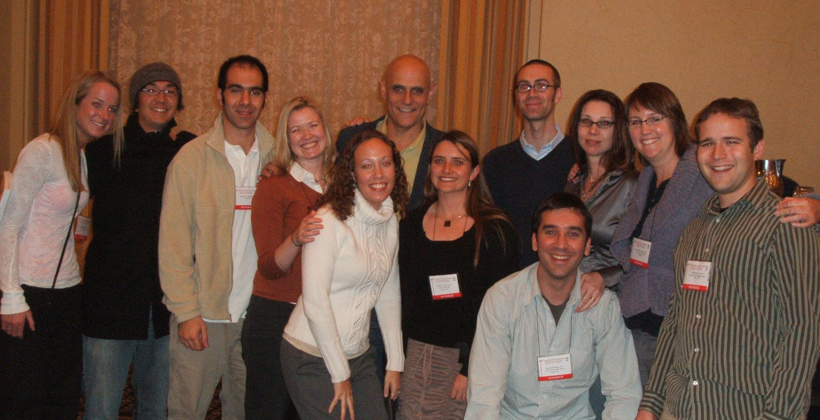
Notes:
Maybe tell Friman story.
Note Mike Levin

Slide 21
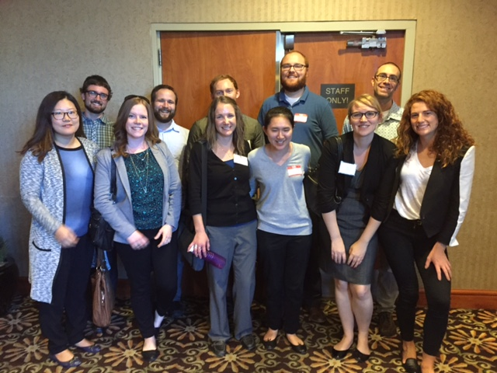

Slide 22
I’m not the first to think this
“The connection between applied work and behavioral principles has weakened dangerously. This weakening, I argue, is partly because behavior analysts did not move quickly enough into basic analyses of human behavior and partly because applied behavioral workers stopped attending to basic issues in their own work or developments in the basic literature.”
Hayes,1987

Slide 23
The concern is still there
“ ‘‘Pure basic’’ science can become detached from the natural world that it is supposed to explain. ‘‘Pure applied’’ work can become detached from fundamental processes that shape the world it is supposed to improve. Neither demands the intellectual support of a broad scholarly community or the material support of society. Translational research can do better by seeking innovation in theory or practice through the synthesis of basic and applied questions, literatures, and methods.”
    Mace & Critchfield, 2010
Notes:
This is an interest shared with many people. But I have to be honest, when I hear this described it does not tackle the complicated clinical issues we deal with.

Slide 24

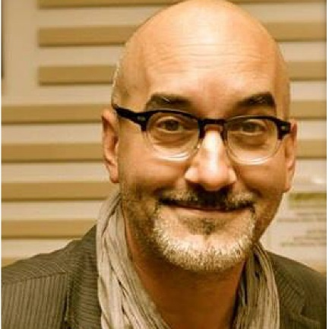
How?
Study design (perspective)
Science for science’s sake
Work in different worlds
“Data speak for themselves”
They are busy
Journals
Grants
Why take on a new topic?
Overall goals may be very different
Notes:
Amy Odum… Dennis Tirch

Slide 25
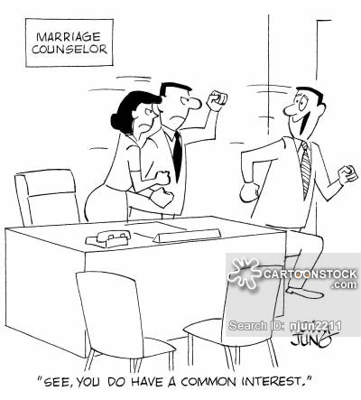
Mutual interest model (Hayes, 1987)
To keep up with basic (or applied) research is unreasonable
Maybe it is possible to keep up, or even be skilled in, one or two areas
When you begin to show an interest, and really
interact, the other person tends to find an
interest in your work
A link forms…a mutual interest

Slide 26
Someone listen!
“If say, 5% or maybe even 0.5% of the active researchers in a given sub-discipline had at least one area of mutual interest outside of their sub-discipline, the cohesiveness of behavioral psychology would increase tremendously.” (Hayes 1987)
“If, say, 1% or ½% of the active researchers …” (Hayes 1988)
“Only a very small number of researchers need to be willing to pursue both sides of the issue (basic and applied) to allow an overall team to cooperate.” (Hayes, long, Levin, & Follette 2013)”

Slide 27
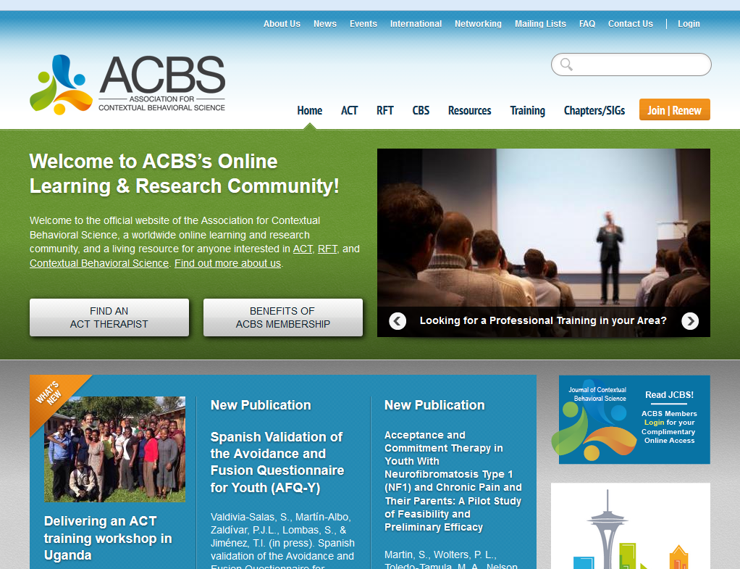
Most of us are familiar with this
Notes:
Note that we are doing a good job at translational

Slide 28

Philosophy: Functional Contextualism
Notes:
Predefined goals
Whole event
Pragmatically useful

Slide 29
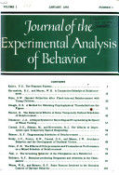
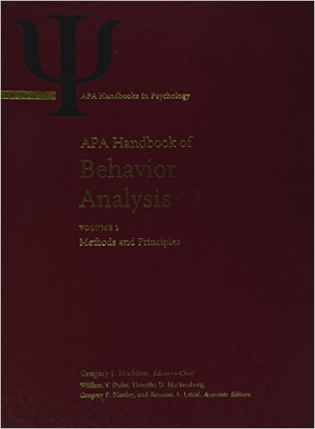
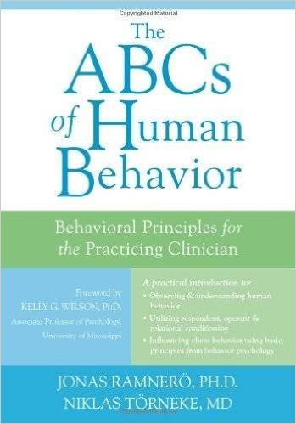
Basic Behavioral Theories are Sound

Slide 30
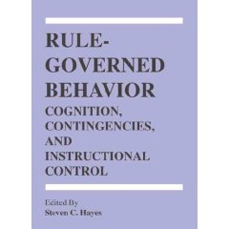
Rule Governed Behavior
Verbal humans are insensitive to
  environmental contingencies
Non-verbal ones are not

Slide 31
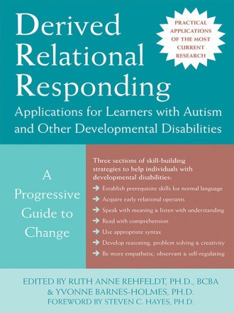
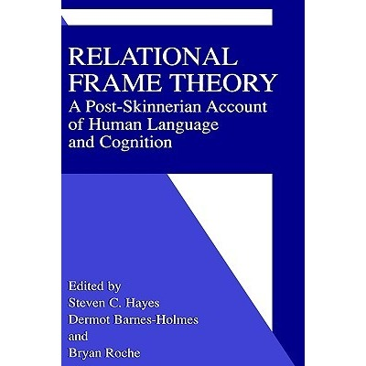
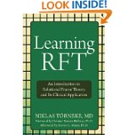
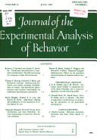
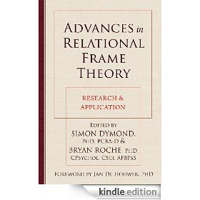

Relational Frame Theory
Stimuli
Three-term contingency
Meaning vs function

Slide 32
The Primary ACT Model of Treatment
Psychological
Flexibility

Slide 33
Effect size by component relative to inactive conditions
Large effect
Medium effect
  Levin et al., 2012 Behavior Therapy

Slide 35
Randomized Controlled Trials
*=children or adolescents
Aggression
Alcohol use*
Adjusting to end-stage cancer
Borderline Personality disorder
Chronic pain*
Chronic headache
Coping with cancer DX
Coping with Cancer Diagnosis
Depression*
Diabetes management
Disordered eating
Epilepsy
Generalized Anxiety Disorder
Health Anxiety
Mixed Anxiety Disorders*
Methamphetamine use
Methadone detoxification
Multicultural competency
OCD
Panic disorder
Polysubstance abuse
Psychosis
Stress of parents with children diagnosed with DD or MR
Social anxiety
Smoking cessation
Shame in substance abusers
Stigma against mental illnesses
Tinnitus distress
Trichotillomania
Use of ESTs
Weight loss
Workplace stress and innovation
Willingness to use ESTs
Workplace burnout
Effectiveness
Notes:
The work has gotten out to the larger audience but fairly poor work within the applied world.
RFT researchers are amazing, but overwhelmend by the applied people.
Example of talk in Reno…Hayes, G Terrence Wilson, Todd Kashdin, Follette……..plumb and Dahl
My values in this area of work.
Building this translation. Really hard with more applied pulls.

Slide 38


My Behavior Analysis Colleagues at USU
Notes:
To really build up a translational program I interacted with these guys

Slide 39
Academic Values
Notes:
Culturally competent research…you don’t just walk in and tell them what they need.
Committees. Readings. Classes. Office meetings.
Greg, it was important to him to have a full understanding of BA and to help BA have an impact

Slide 40
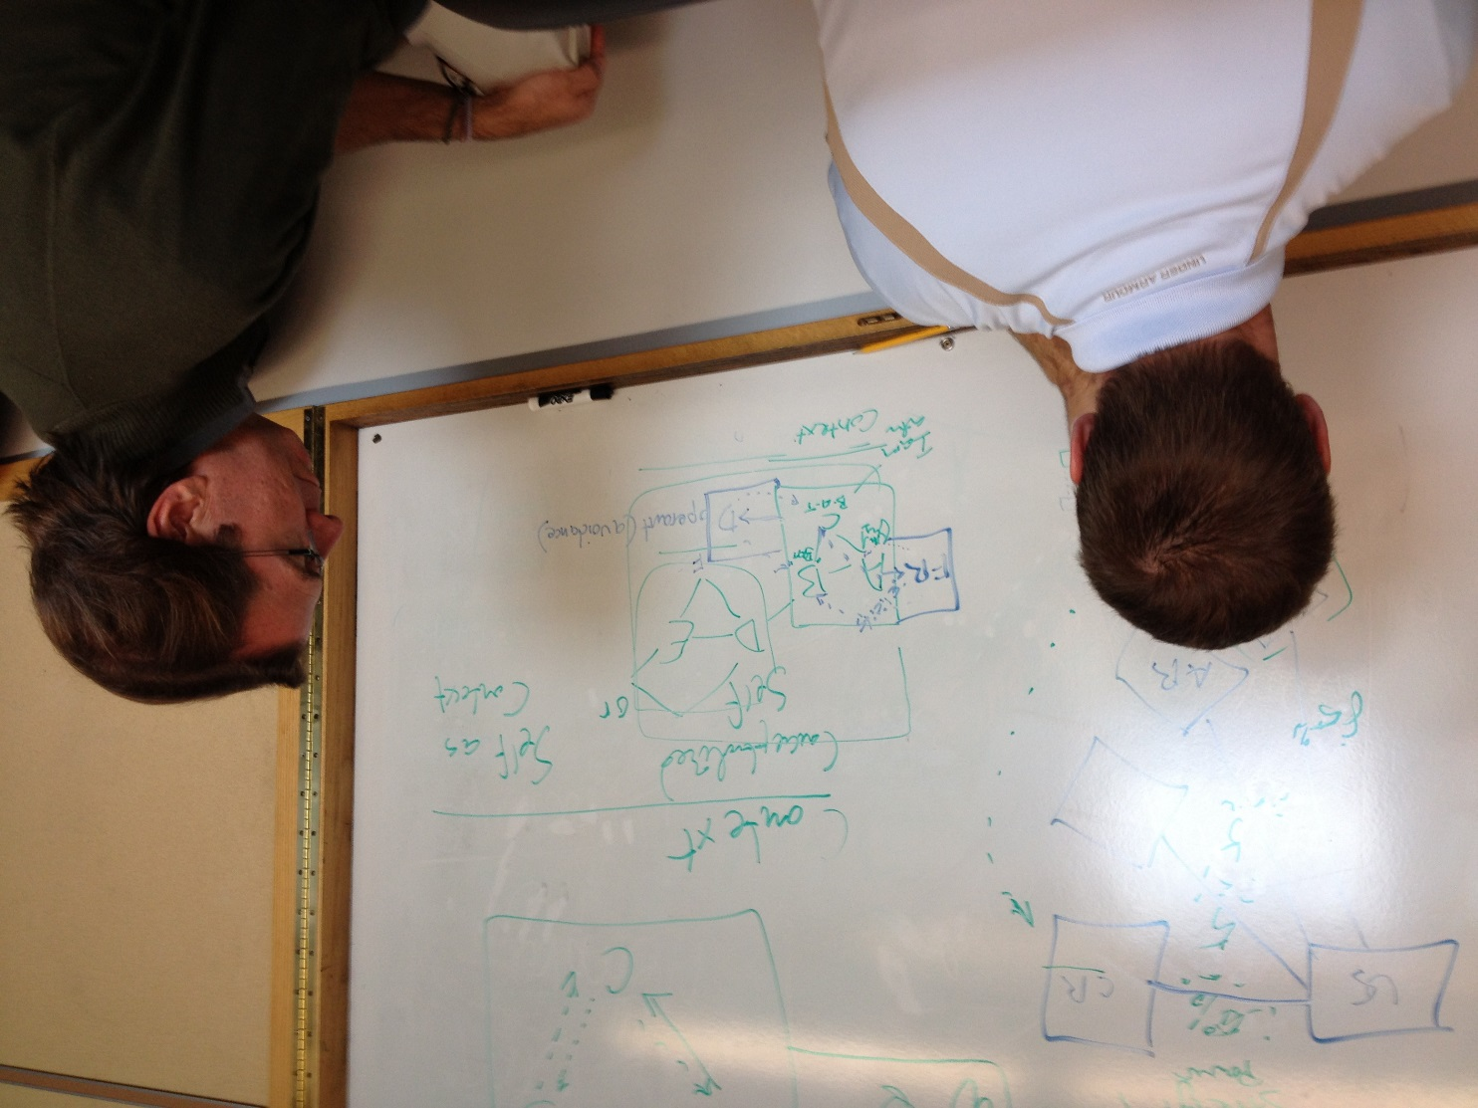

Slide 41
Translational work

Slide 52

Delay Discounting: What is it?
As the interval between response and reinforcer increases, the value of the reinforcer declines.
Value

Slide 53

Delay Discounting: What is it?
As the interval between response and reinforcer increases, the value of the reinforcer declines.
Value
Delay

Slide 54
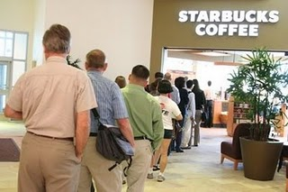
Delay Discounting: What is it?
As the interval between response and reinforcer increases, the value of the reinforcer declines.
Value
Delay

Slide 55
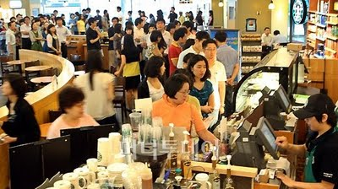
Delay Discounting: What is it?
As the interval between response and reinforcer increases, the value of the reinforcer declines.
Value
Delay

Slide 56
Delay Discounting: What is it?
As the interval between response and reinforcer increases, the value of the reinforcer declines.
Value
Delay

Slide 57
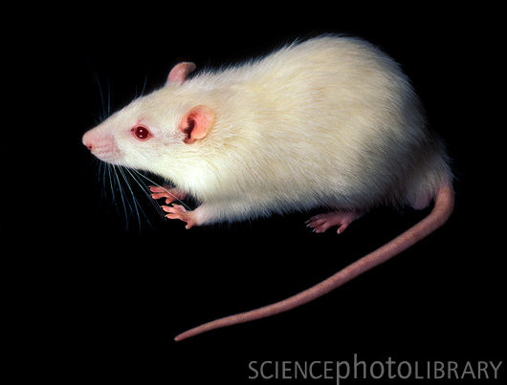
Delay Discounting
As the interval between response and reinforcer increases, the value of the reinforcer declines.
Richards et al. (1997))
Value
Delay

Slide 58
Delay Discounting…the flipside
Tendency for the present value of a reward to increase with proximity to its receipt
Consistent Preference
Preference Reversal
Notes:
Find a better way to show this

Slide 59
Delay discounting is associated with
Increased severity of substance use
Increased number of substances used
Increased needle sharing in an opioid using population
Future substance use
Poor treatment outcomes for nicotine
Cocaine use
Poor marijuana abstinence
Higher rates of cocaine self-administration in rats
Resistance to extinction and an increased risk for relapse
Alcohol use
Tobacco use
Opiate use
Stimulant use
Pathological gambling
Pathological video gaming
Obsessive-compulsive personality disorder
Antisocial personality disorder
Obesity
Problematic pornography viewing
Criminal thinking
Co-occurring risky sexual behavior and alcohol use

Slide 60
Delay Discounting and OCD
“After using a public restroom, you are about to leave and as you grab the door handle to exit you notice a sticky, gooey substance is on the handle and is now on your hand. On the floor next to the door you see a used and discarded tissue with the same mucous-like substance that is now on your hand. This substance is not seriously harmful to your health and has no adverse consequences other than the unpleasantness normally associated with another person’s mucous on your hand. Before you are able to remove this substance imagine you are presented with the following choices:”
Ong, Graves, Berry, Odum & Twohig (in prep.)

Slide 61
Ong, Graves, Berry, Odum & Twohig (in prep.)
Notes:
Greg and Amy knew that it occurred, how it occurred, for whom it occurred, how to measure, its parameters….but reviewers and grant agencies were asking “what are you going to do about it?”

Slide 63
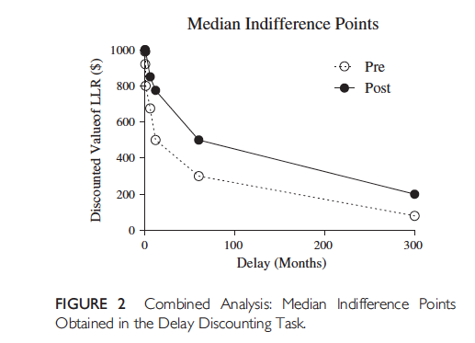
College Students with Steep Discounting
Morrison, Madden, Odum, Friedel & Twohig (2014)

Slide 64
Clients with clinical pathology and steep discounting
Morrison, dissertation defense on July 8th

Slide 65
Clients with clinical pathology and steep discounting
Mid
Post

Slide 66
Clients with clinical pathology and steep discounting
Pre
Mid
Post

Slide 67
Clients with clinical pathology and steep discounting
Pre
Mid
Post

Slide 68
Clients with clinical pathology and steep discounting
Pre
Mid
Post

Slide 69







Current project
Notes:
This relationship is going to be pretty consistent.

Slide 70
Why is basic work important?
Extinction
  Operant and classical
“The omission of previously delivered unconditioned stimuli or reinforcers; however, it also has been defined as the absence of a contingency between response and reinforcer or between conditional and unconditional stimulus
At a functional…level extinction describes the decreases in responding from higher levels observed prior to extinction to lower levels…” (Lattal & Lattal, 2012)
Qualifications:
Duration and degree depend how much conditions change
Extinction may cause other responses to be generated
Even if response is completely eliminated certain conditions will cause a return
Notes:
Extinction is a huge part of lots of our lives ignoring problem behavior in kids, part if time out, quitting any habit, ….for me treatment of anxiety disorders

Slide 71
Resurgence- Reappearance of extinguished behavior when an alternative behavior introduced during extinction is subsequently also placed on extinction
Notes:
- Reappearance of extinguished behavior when an alternative behavior introduced during extinction is subsequently also placed on extinction
I was on this thesis.
One important finding within the resurgence literature is
While higher rates of alternative reinforcement tend to result in faster and more complete extinction of target behavior
They also result in more resurgence of target behavior once alternative reinforcement has been removed
In addition, lean rates of alternative reinforcement can have either
No effect on the rate of extinction of target behavior,
Or actually have a detrimental effect by hindering extinction
While sometimes still resulting in resurgence
These findings could have important implications for clinicians treating anxiety
As higher rates of alternative reinforcement
While being more effective at reducing undesired avoidance
May have the unintended side effect of producing greater relapse of avoidance if access to positive reinforcement later becomes unavailable
such as with the loss of a job, loss of a relationship, or simply no longer engaging in alternative behaviors

Slide 72
Extinction phase
McSweeney & Shahan (2013)
Notes:
32 rats in different conditions
Really explain slides
Bar press alcohol
Chain pull food

Slide 73
Resurgence phase
McSweeney & Shahan (2013)
Notes:
I found this totally interesting as it’s like what we see when we train a new behavior in ACT
Example drinking, girlfriend, loses girlfriend

Slide 74
Smith, Madden, Shahan, Smith, & Twohig (in prep)

Slide 75
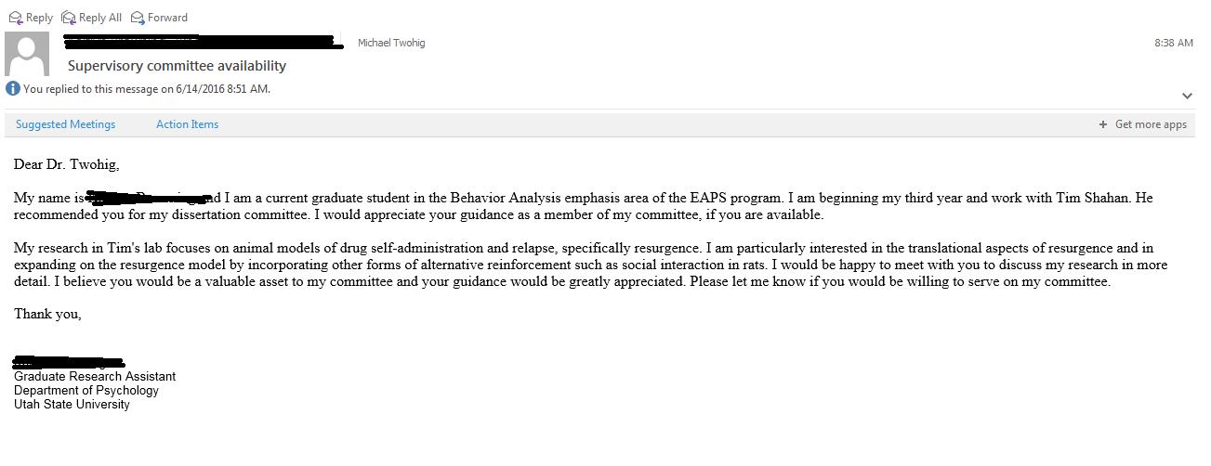

Slide 76
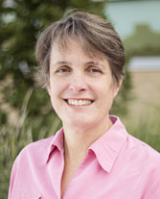
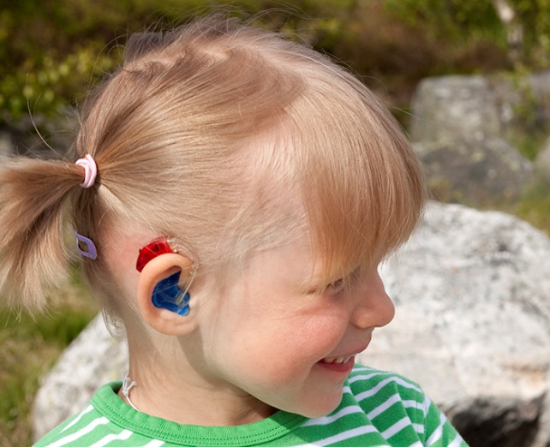
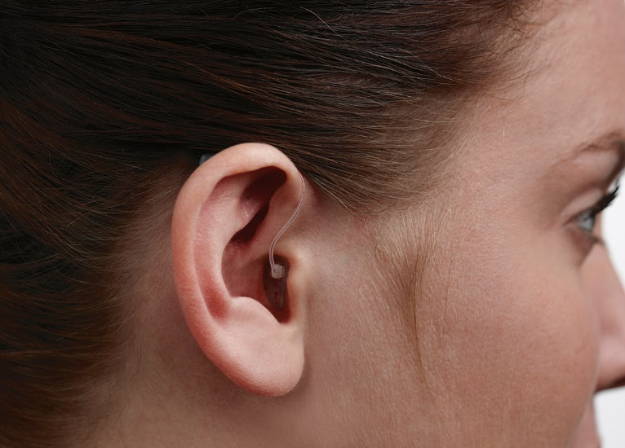
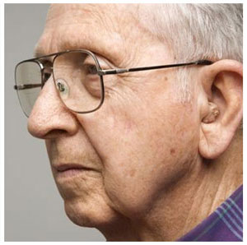
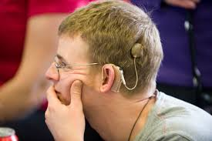
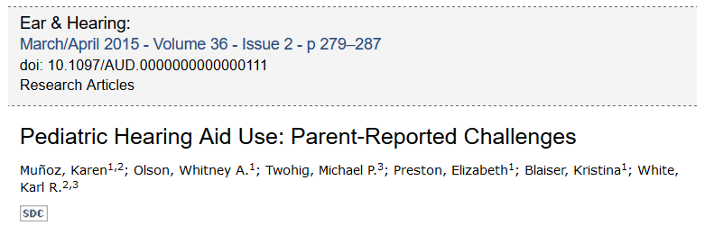
One where tables were turned: Audiology
Notes:
Dug into issue
Sat on lots of committees
Many conversations
Worked with them…now starting a co-lab program
Parents did not like making kids feel bad
Audiologists did not really know how to address this
Super successful line of work that is mutually beneficial

Slide 77
Challenge: Reach
What is one of your main areas of work?
What is a line of basic/laboratory research that informs it?
Who is a leader in that area?
Look up his or her most cited paper and read it.
Keep going from there.

Slide 78
Here’s what will happen
Mind chatter
Feel frustrated
There will be better things to do
You won’t have the time
More mind chatter

Slide 79
Keep moving
Connect with why this might be worth it
Think about you in grad school
Take small steps in a direction you find meaningful
Honestly check in if it’s worth it
If it is keep going
If not, do something else
If you actually get a collaborator
  It can be odd

Slide 80

Notes:
We have a journal for this….
I have not been at this that long. But I’ve seen huge changes in just a couple decades.
Still a lot of work to do….almost seems “overwhelming”….

Slide 81
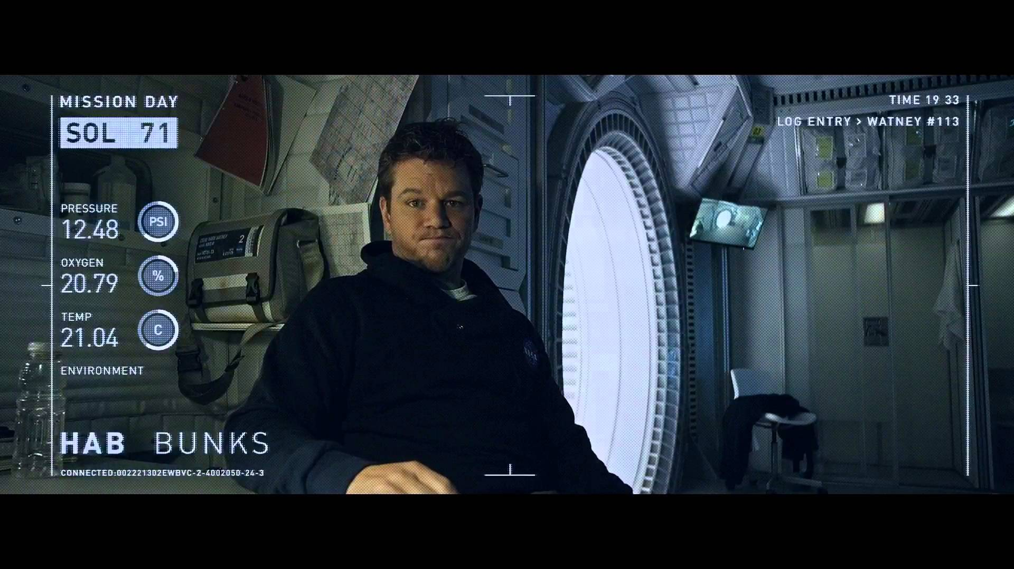
“In the face of overwhelming odds I’m faced with only one option,”

Slide 82
“I’m going to have to science the shit out of this.” Matt Damon in The Martian

Slide 83


